Slide 1



Bridge to Medicare
12089s0419

Slide 2


Introductions
Robin Depenbrock
Pivot Health
Director of Agency Services
Liz Cissner
Allied National
Account Executive

Slide 3
Health care is expensive, health insurance doesn’t need to be.
Robin Depenbrock, Director of Agency Services
For Agent use only. Not for distribution

Slide 4




Who is pivot health
Launched in 2016, Pivot Health is a product development, management and marketing company providing alternative insurance solutions to the individual marketplace.
Our team is made up of proven successful marketers, risk managers, product development experts. Founded by innovative experienced insurance leadership collectively managing more than $7 billion of insurance premium.
Grew from $5 million in revenue in 2017 to $44 million in revenue in 2018.
For Agent use only. Not for distribution

Slide 5

What does the market look like
Big and getting bigger
Diverse and dynamic
Demands speed and simplicity
Permanent is ending; on demand beginning

Slide 6
Pivot Health STM Products
For Agent use only. Not for distribution

Slide 7

Short Term Medical MARKET
An important niche market for 40+ years.
The number of individuals covered is about 1.5 million – and this will will likely more than double in 2020
The total in-force premium for STM plans is expected to grow from less than $1.5B to more than $5B by 2021.
For Agent use only. Not for distribution

Slide 8



Short Term Medical – Coverage for all stages of life
Core Plans
Classic Plans
Bridge to MedicareTM
Low Deductibles
Doctor Visit Copays
First Health Network
Rx Coverage Available
Child Only
Fixed Hospitalization Benefits
Plans with Doctor Visit Copays
Rx Coverage
Child Only
Open Access – no network restrictions
Multiple Duration Options
Exclusive to 62-64 & 11 months (primary)
3 x 12 Month Plans Issued at One Time
No New Underwriting
Rx Coverage
Lower Rate than ACA
Higher LTV for the Agent
For Agent use only. Not for distribution

Slide 9
What makes Pivot Health STM plans unique?
Array of plan and duration options to find a plan that best fits your clients’ needs and budget
Plan options include: prescription coverage, doctor visit copays, up to $1M of maximum coverage
Coverage can start in 24 hours from enrollment
Eligibility age 6 months – 64 years and 11 months
Accept Child only applications starting at 6 months old
Cover high school and college athletes
Core Plans - One of the largest PPO networks in the nation
Classic Plans - No Network Restrictions – Freedom of Choice
For Agent use only. Not for distribution
*coverage duration varies by state
Notes:
Open Access network is based on reference based pricing. Client receives an id card. The id card has the reimbursement on the card and a benefit fit verification number for providers to call to get benefit information. Claims are filed just like they would be with a network plan. They are sent to our administrator, Allied National to be repriced. Claims are repriced based on the Reference Based Pricing amount which equates to about a 60% discount. We offer a NO BALANCE BILL Guarantee. If the insured receives a balance bill from their provider they can send the bill to Allied who uses a third party to negotiate with the doctor the balance bill. Any additional negotiated rate will be paid by Pivot. The insured will not be responsible for balance bill portion.

Slide 10
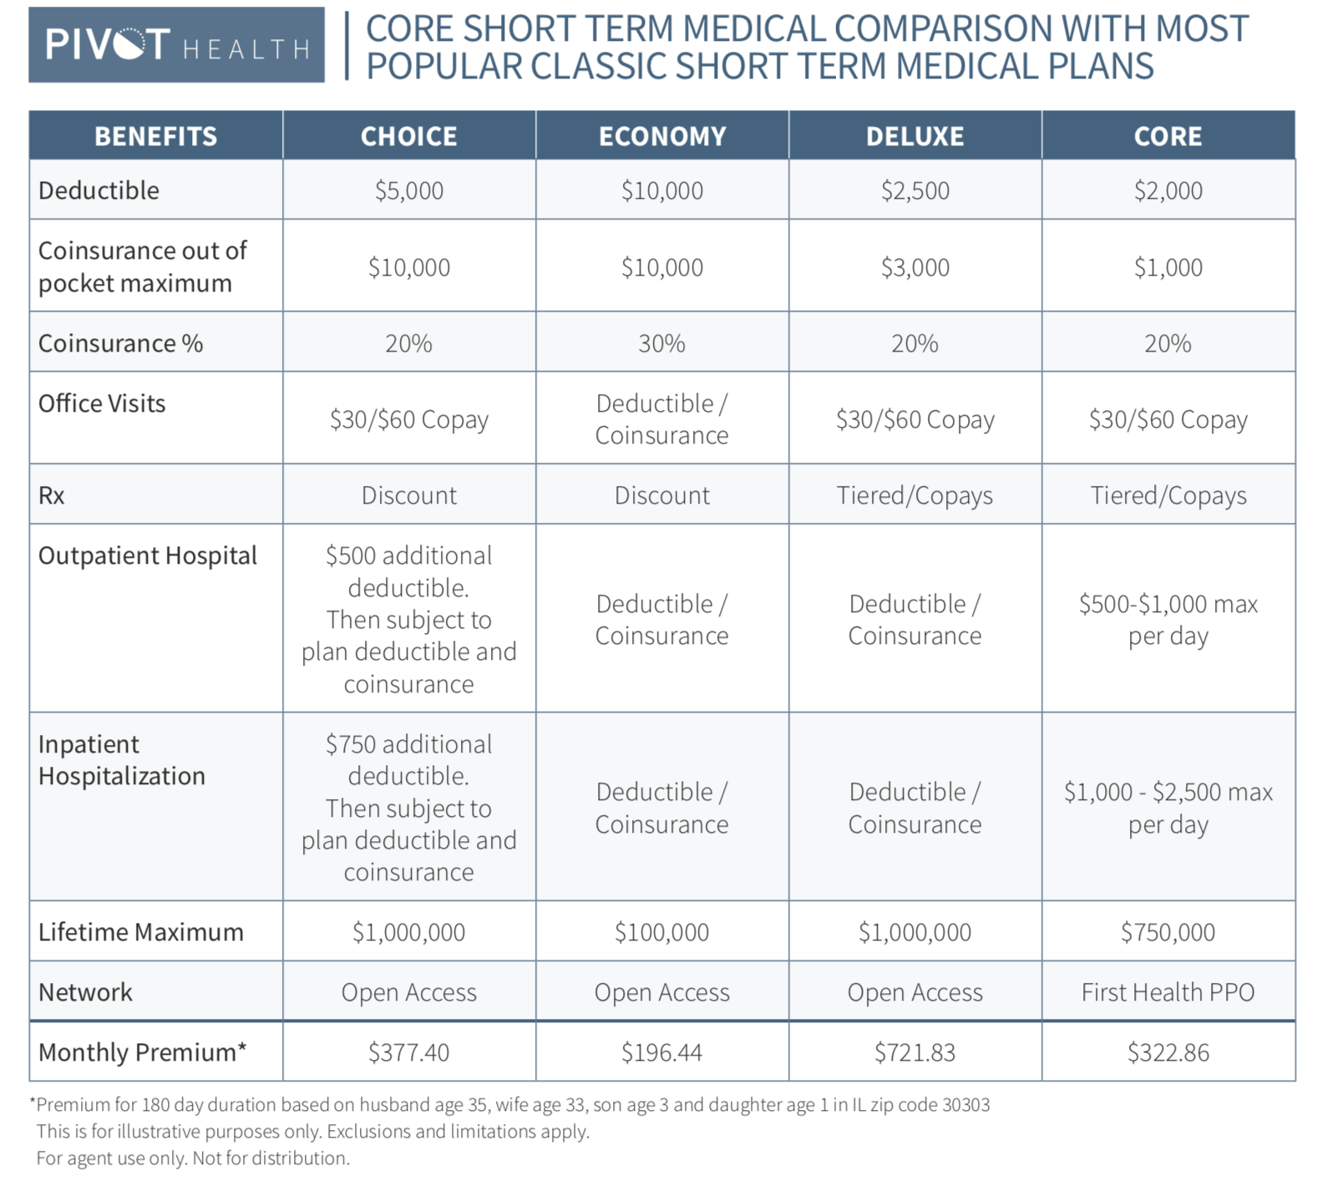
STM Plan Comparison
For Agent use only. Not for distribution

Slide 11
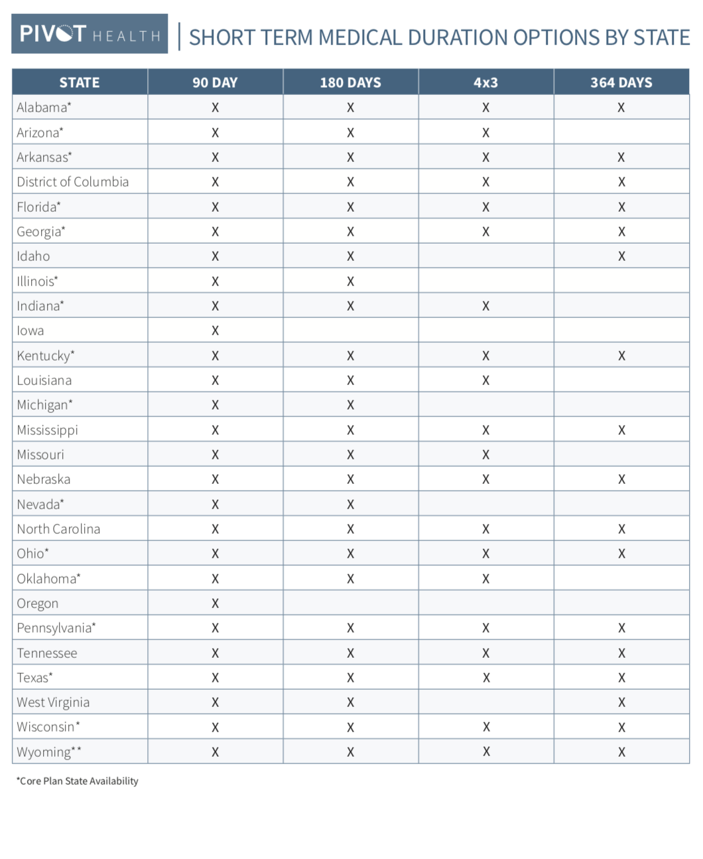
4x3 Longer Duration
****This document is subject to change based state filings final determination of duration.
For Agent use only. Not for distribution
Notes:
Duration options by state availability/. This chart is subject to change.

Slide 12
No Network restrictions
No Network Restrictions – Freedom of Choice. Pivot pays Medicare Plus - up to 150% of Medicare allowable for facilities and up to 125% of Medicare allowable for physicians/professional services.
Provider submits their claims to Insurance Benefit Administrators (Allied). Bills are repriced according to the percentages of Medicare allowed amounts, based on the Medicare fee schedule. Payment is made to the provider based on this amount and the reduction is shown as a discount by the provider.
If a provider wishes to review and discuss the allowed amount or initially objects to the reimbursement amount, the provider can contact the Benefit Verification line at 866-323-2985.
“NO BALANCE BILL” charges for the insured.
For Agent use only. Not for distribution.

Slide 13
Reference Based Pricing Claims Example
59 year old female, Grand Island, NE 68801
Procedure CPT: Code 73221 MRI (any joint or upper extremity)
Billed Amount | $1,060.00
Medicare Allowable | $222.72
RBP at 125% | $278.40
Deductible met: (80/20) Insured Out of Pocket | $55.69
Deductible not met: Insured Out of Pocket | $278.40
For Agent use only. Not for distribution

Slide 14
RBP Balance Bills/Appeals History
Time Frame | 2018
Months | 12 Months
RBP Pricing # of Eligible Claims | 63,589
Claims Reimbursement Appeals | 376
% Claims Appeals | 0.59%
# Appeals with no Discount Allowed | 14
For Agent use only. Not for distribution

Slide 15

Who is buying
Core Plans
Classic Plans
34% policies age 25-39
10% policies < age 17
35% policies age 25-39
10% policies age 62-64
For Agent use only. Not for distribution

Slide 16

The Bridge To MedicareTM Plan
A health insurance solution for pre-Medicare Individuals
Robin Depenbrock, Director of Agency Services
For Agent use only. Not for distribution.

Slide 17
The Market
12 million of the 77 million baby boomers (54-72) in the US are between age 61.5 and 64.5 -that’s 28% of the population
10,000 people are turning 65 every day and this will continue into 2030
45% of baby boomers consider themselves to be entrepreneurs
About 50% have incomes that make them ineligible for ACA Subsidies
12% of Pivot Health’s current customers are 60 plus*
http://www.bbhq.com/bomrstat.htm
https://www.fool.com/retirement/2017/07/29/9-baby-boomer-statistics-that-blow-you-away.aspx
* Based on 2018 sales data
For Agent use only. Not for distribution.

Slide 18

The problem
For those not subsidy eligible, ACA plans are unaffordable and unworkable
The Life Time Value (LTV) of a sale for those on an ACA plan is very low
ACA persistency is low and customers are forced to shop every year
ACA carrier options have diminished
GALLUP BLOG
U.S. Seniors Pay Billions, yet Many Cannot Afford Healthcare
For Agent use only. Not for distribution.

Slide 19
What we know
eHealth 3/4/19 survey of more than 800 short term health enrollees finds older enrollees are more likely than younger ones to consider short-term insurance as an affordable alternative to ACA
70% ages 55-64 cite affordability as primary reason for choosing short term vs 53% ages 18-24
88% ages 55-64 say they value affordable monthly premiums more than comprehensive coverage vs 78% ages 18-24
64% ages 55-64 say they would retain short-term coverage for 7 months or longer vs 56% ages 18-24 say they will keep their policy for no more than 6 months
For Agent use only. Not for distribution

Slide 20
The solution
What if you could offer a unique choice that:
Provides additional coverage compared to traditional short term medical
Increase life-time value of customer
Offers first dollar benefits
Allows transition to Medicare with lower acquisition cost
Takes less than 15 minutes to complete an enrollment
Introducing…
The Bridge To Medicare Plan
- a proprietary product of Pivot Health + HealthCare.com
For Agent use only. Not for distribution.

Slide 21
The Solution - The Bridge To MedicareTM Plan
Age 62-64 &11 months eligible
Three 364 day policies issued at one time with no additional underwriting, no new pre-ex look back or waiting periods for the 2nd and 3rd plan years
Bridge to Medicare combines short term health coverage with fixed first dollar benefits that supplements everyday medical expenses like:
  Doctor office visits
  Preventive care
  Testing
  Outpatient Surgery
  Hospital Stays
Discounts on telemedicine, Rx, Vision and Audiology
For Agent use only. Not for distribution.

Slide 22
How do benefits work?
Coverage A: Short Term Medical plan for unexpected, large medical expenses
Covered expenses go toward the deductible and coinsurance
Individuals are responsible for deductible and coinsurance up to the out-of-pocket maximum
Coverage B: Fixed dollar limited benefit plan to help supplement medical expenses
Doctor Office visits
Preventive Care
Testing
Outpatient surgery
…Combines two insurance coverages into ONE package!
For Agent use only. Not for distribution.

Slide 23
How does the Plan work
Three 364 day policies are issued at time of enrollment
Each new coverage period, new certificates and ID cards are issued
New deductibles, out of pocket maximums and coverage maximums start over
No new medical qualifying questions
No new pre-x limitations
No new waiting periods
One-time enrollment fee
Cancel at anytime
For Agent use only. Not for distribution.

Slide 24
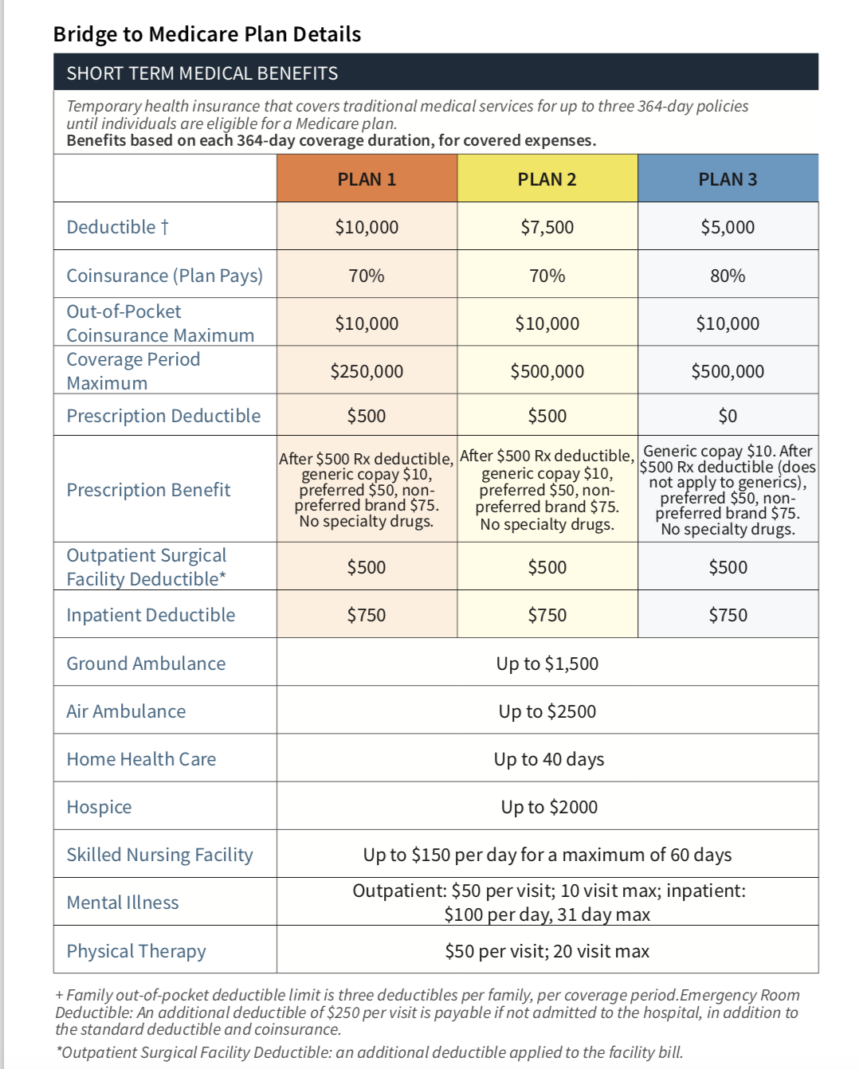
THE BRIDGE TO MEDICARE PLAN DETAILS
For Agent use only. Not for distribution.

Slide 25
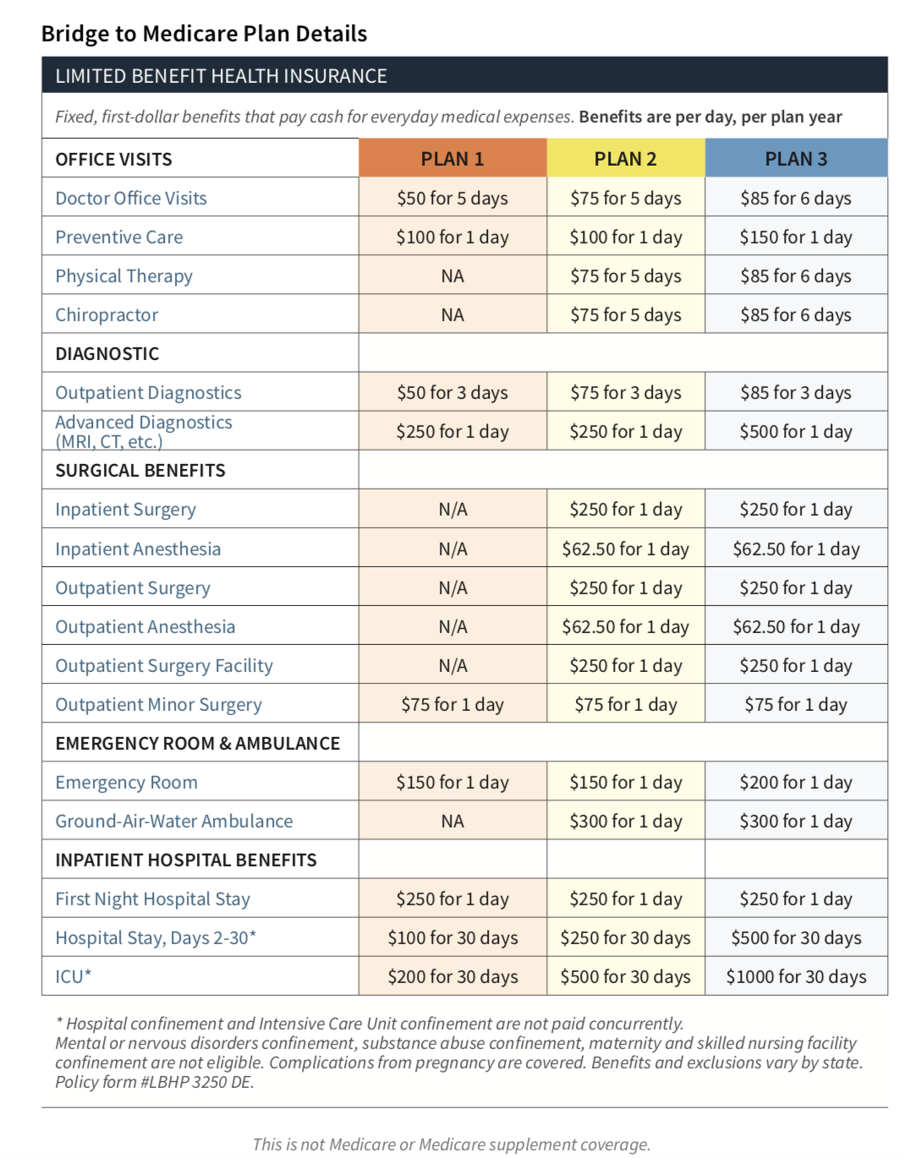
THE BRIDGE TO MEDICARE PLAN DETAILS CONT.
For Agent use only. Not for distribution.

Slide 26
ADDED ASSOCIATION BENEFITS
Telemedicine – Doctor on Demand
  $49 fee reimbursed
Discount Prescription drugs
  Up to 70% savings on RX
Discount Vision & Audiology
For Agent use only. Not for distribution.

Slide 27
Rate comparison
State | Demographic | Carrier Plan | Monthly Premium
Cincinnati, OH | Male, age 63 | BCBS $5K Bronze HMO | $820.00
45255 |  | BCBS $5K Silver HMO | $1,067.23
 |  | MMO $5,200 HMO/HSA | $833.83
 |  | PIVOT BTM $5K PLAN 3 | $580.52
Tampa, FL | Female, age 63 | Molina $6,400 | $906.98
33601 |  | Ambetter $7,350 | $1,097.00
 |  | PIVOT BTM $5K PLAN 3 | $684.00
Harrisburg, PA | Husband & Wife
17101 | Age 62, Age 62 | Highmark $7,900 | $1,919.04
 |  | PIVOT BTM $5K PLAN 3 | $1,244.89
For Agent use only. Not for distribution.

Slide 28
No Network restrictions
No Network Restrictions – Freedom of Choice. Pivot pays Medicare Plus - up to 150% of Medicare allowable for facilities and up to 125% of Medicare allowable for physicians/professional services.
Provider submits their claims to Insurance Benefit Administrators (Allied). Bills are repriced according to the percentages of Medicare allowed amounts, based on the Medicare fee schedule. Payment is made to the provider based on this amount and the reduction is shown as a discount by the provider.
If a provider wishes to review and discuss the allowed amount or initially objects to the reimbursement amount, the provider can contact the Benefit Verification line at 866-323-2985.
“NO BALANCE BILL” charges for the insured.
For Agent use only. Not for distribution.

Slide 29
Bridge To Medicare Claims Example
His scenario applies to the following claims example:
A 63-year old falls and incurs the following
Ambulance transfer to the hospital
Emergency room visit
X-ray of the pelvis a
1-night stay in the hospital for observation.
Charges calculated from https://www.fairhealthconsumer.org/ in Zip code 53558. Obamacare plan estimate from Healthcare.com
For Agent use only. Not for distribution.

Slide 30
Bridge To Medicare Claim Example
Bridge To Medicare Plan 3
Medical Service | Estimated Cost* | Coverage A: STM Insurance Pays | Coverage B: LMB Insurance Pays | Patient Responsibility
Ambulance | $367 | $0 (Deductible must be met first) | $300 | $67
Emergency Room | $522 | $0 (Deductible must be met first) | $0 | $522
X-ray | $178 | $0 (Deductible must be met first) | $0 | $178
Hospital Stay | $424 | $0 (Deductible must be met first) | $750 | $0 ($326 over cost paid to patient)
Patient responsibility is $441
Obamacare Silver Plan with $5,000 Deductible
Medical Service | Estimated Cost* | Insurance Pays | Patient Responsibility
Ambulance | $367 | $0 (Deductible must be met first) | $367
Emergency Room | $522 | $0 (Deductible must be met first) | $325 copay
X-ray | $178 | $0 Deductible must be met first | $178
Hospital Stay | $424 | $0 Deductible must be met first | $424
Patient responsibility is $1,294
Charges calculated from https://www.fairhealthconsumer.org/
in Zip code 53558. Obamacare plan estimate from Healthcare.com
For Agent use only. Not for distribution.

Slide 31
The Bridge to Medicare Plan State Availability
ALABAMA | KENTUCKY
ARKANSAS | OHIO
FLORIDA | PENNSYLVANIA
GEORGIA | TEXAS
 | VIRGINIA
Current as of 12/12/18
For Agent use only. Not for distribution.

Slide 32
Pivot Health’s STM – The Process
Quoting:
Bridge To Medicare available in Product tab at the top of quoting page
Applying:
Simplified underwriting – 5 medical questions
Applicant – age 62 – 64 years & 11 months
  Coverage can include spouse (up to age 65 yrs.) and Child(ren)
Accept/reject on the spot
eSignature for self-service
Coverage effective date as soon as next day up to 60 days in advance
10 day free look
Waiting periods do apply – 5 day wait for sickness & prescription drug fulfillment, 30 day wait for cancer
For Agent use only. Not for distribution.

Slide 33
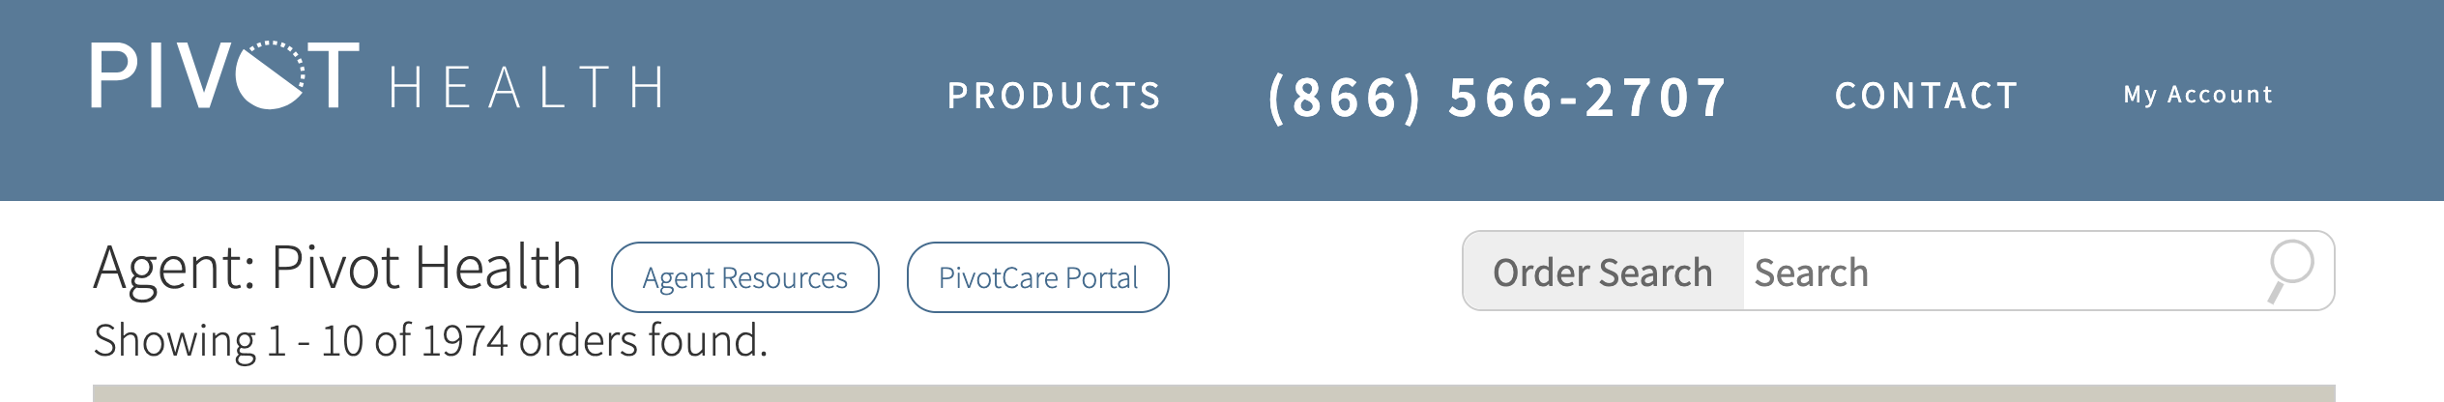
Agent Resource Page
What does Pivot offer to help you sell more
https://www.pivothealth.com/agent/admin/login
For Agent use only. Not for distribution

Slide 34

Getting Started
For Agent use only. Not for distribution

Slide 35
Pivot Health’s STM – Medical Knock Out Questions
Yes to any of the 5 questions: coverage can not be issued
Will any applicant have other health insurance in force on the policy effective date or be eligible for Medicaid? Have/Are you, or any applicant:
  Been denied insurance due to any health reasons for a condition that is still present?
  Now pregnant, in process of adoption or undergoing fertility treatment?
  Over 300 pounds if male or over 250 pounds if female?
  Been advised by a medical professional to have diagnostic testing, treatment, surgery that has not yet been completed?
Within the last 5 years has any applicant had a diagnosis, symptoms, an abnormal test result or received treatment, medication or consultation for:
cancer or malignant melanoma; atrial fibrillation or abnormal heart rhythm, heart disorders, angina, heart attack or heart failure; stroke; uncontrolled hypertension; diabetes except gestational; hepatitis C or liver or kidney disorders; organ transplant; chronic obstructive pulmonary disease (COPD) or emphysema; rheumatoid arthritis or degenerative disk disease; hemophilia, leukemia or blood disorders; multiple dystrophy or sclerosis; alcohol or drug abuse or misuse; bipolar, schizophrenia; or eating disorders?
Medical questions vary by state
For Agent use only. Not for distribution.

Slide 36
Pivot Health’s STM – Medical Knock Out Questions Cont.
Yes to any of the 5 questions: coverage can not be issued
Within the last 5 years has any applicant been diagnosed or treated by a physician or medical practitioner for Acquired Immune Deficiency Syndrome (AIDS) or tested positive for Human Immunodeficiency Virus (HIV)?
If all persons to be insured are United States citizens, please answer “No” to this question. If any person to be insured is not a United States citizen, has that person resided outside the United States at any time during the prior 12 months?
Medical questions vary by state
For Agent use only. Not for distribution.

Slide 37
Pivot Health-What is Considered a
Pre-existing Condition
This plan has pre-existing limitation provision that may prevent coverage from applying to medical conditions that exist prior to this plan effective date.
Pre-existing Conditions expenses are medical charges resulting directly or indirectly from a condition for which a Covered Person received medical treatment, diagnosis, care or advice within sixty-month period immediately preceding such person’s effective date.
Pre-existing look back period varies by state.
For Agent use only. Not for distribution.

Slide 38
What’s new?

Slide 39
Rate reductions
STM Rate reduction in 18 states*:
Michigan - 21% average reduction
Pennsylvania - 18% average reduction
Arkansas - 14% average reduction
Arizona - 12% average reduction
Florida, Illinois - 11% average reduction
Ohio, Iowa, Alabama, Kentucky, Oklahoma, West Virginia, Mississippi, Wyoming - 8% average reduction
Indiana - 4% average reduction
Texas, Wisconsin - 3% average reduction
*% of rate reduction varies by zip

Slide 40
Bridge to Medicare bonus
We will pay agents $75 for every submitted and approved Bridge to MedicareTM application submitted April 1st – June 30th.
It’s as simple as 1-2-3!
Approved application submitted April - June
Agent bonus $75
REPEAT!
Bonus for The Bridge to Medicare Plan from Pivot Health. Bonus period for submitted and
approved applications is April 1st – June 30th, 2019. Effective dates no later than 7/15/19.
Policies must stay inforce for 90 days. Bonus will be paid in August 2019. Follows assignment of commissions.
Pivot Health, at its sole discretion, can disqualify any producing agency or agent in the event of erroneous or fraudulently
submitted applications, or duplicate applications for membership and insurance products.

Slide 41

Questions

Slide 42
Thank you
Allied National Sales
Dan Meylan: National Sales Director; 913-945-4253
  Randy Wehner: Sales Manager; 913-945-4267
  Jill Carroll: Account Executive; 913-945-4255
  Jerri Moise: Account Executive; 913-945-4261
  Liz Cissner: Account Executive; 913-945-4130
  Tim Shrout: Associate Director; 913-945-4254

